Slide 1

EDA for The top 5 Indian moves
By :
Ebtesam Sultan
Nuha Aljohani

Slide 2
outline
Questions that data will answer
Answer and conclusion
introduction
Design
Data
Algorithms
Tools
Object of project
Description of the data
Libraries and programs that were used

Slide 3
Introduction
Recently, websites and applications for watching movies have spread .
most people are watching movies.
Some people prefer Arabic moves, and another prefer foreign moves .
Object of project :
* we will give you the top 5 Indian moves
from 2019 to 2021 ...

Slide 4
Design
What is the Indian movies has high rating and votes from 2019 to 2021?
What is the most type of Indian movies watched from 2019 to 2021?

Slide 5
Data
we extracted our dataset from Data.World website and scraped data from IMDb with 15506 number of rows and 10 number of columns.
The Columns include (name, year, duration, genre, rating, number of votes, director and the 3 main actors in the movies) with data type (integer, string).

Slide 6
Data
Drop a null value from the data set.
Convert Column name to Upper case.
Remove symbols from Columns.
Count number of VOTET and RATING.

Slide 7
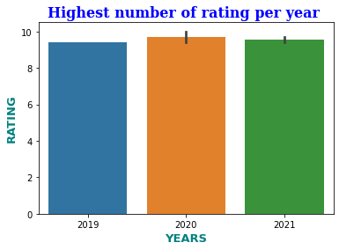
Algorithms
Highest number of ratings per year 2019 to 2021:

Slide 8
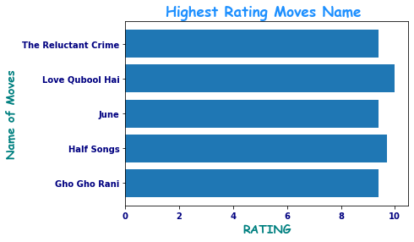
Algorithms
What is the Indian movies has high rating from 2019 to 2021?

Slide 9
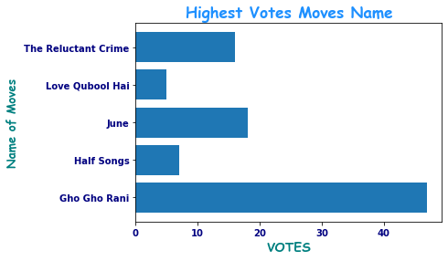
Algorithms
What is the Indian movies has high votes from 2019 to 2021?

Slide 10
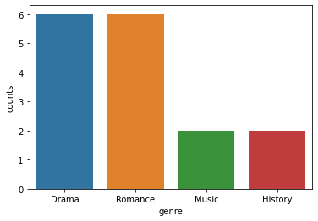
Algorithms
What is the most type of Indian movies watched from 2019 to 2021?

Slide 11


Conclusion
01
02
03
Top moves by rating :
Love qubool hai
THE Top move by Votes :
Gho Gho Rani
Most type of moves :
Drama
Romance

Slide 12
Thank you
Do you have any questions?

